Slide 1
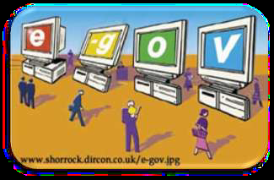
What is e-governance?
E-governance is the application of
Information Technology to the
processes of government functioning
to bring about…
Smart
Moral
Accountable
Responsive
Transparent Governance.

Slide 2
Definition of eGov
It can be defined as the civil and political conduct of government, including service provision, using information and communication technologies
Transactions
Government
Government
Citizens
e-Gov solution

Slide 3
What is E-Government?
E-government refers to the delivery of
national or local government information and
services via the Internet or other digital means
to citizens or businesses or other
Governmental agencies. E-government is a
one-stop Internet gateway to major
Government services.

Slide 4
Background: What is Governance?
Governance
Way govt. works
Sharing of
information
Service delivery

Slide 5
Background: How e-governance helps
Governance
E-governance
Good governance
Bad governance

Slide 6
What is Governance System?
Corporate governance is the system of rules,
practices and processes by which a company is directed and controlled.
• Corporate governance essentially involves
balancing the interests of a company's many
stakeholders, such as shareholders,
management, customers, suppliers, financiers, government and the community.

Slide 7
What is good governance?
Good governance is an indeterminate term
used in the international development
literature to describe how public institutions
conduct public affairs and manage public
resources.
• Governance is "the process of decision-making and the process by which decisions are implemented (or not implemented)".

Slide 8
What is the concept of governance?
Governance has been defined to refer to
structures and processes that are designed to ensure accountability, transparency,
responsiveness, rule of law, stability, equity
and inclusiveness, empowerment, and broad – based participation

Slide 9
About: E-Governance Definition
ICT - Enabling e-governance through ICT(Information and Communication Technology) contributes to Good governance, Trust and Accountability, Citizen's awareness and empowerment, Citizen's welfare
Efficiency
Productivity
Reach
Sharing of information
Service delivery
Welfare

Slide 10
About: E-Governance target agents
business
Government
service delivery
Govt.
citizens

Slide 11
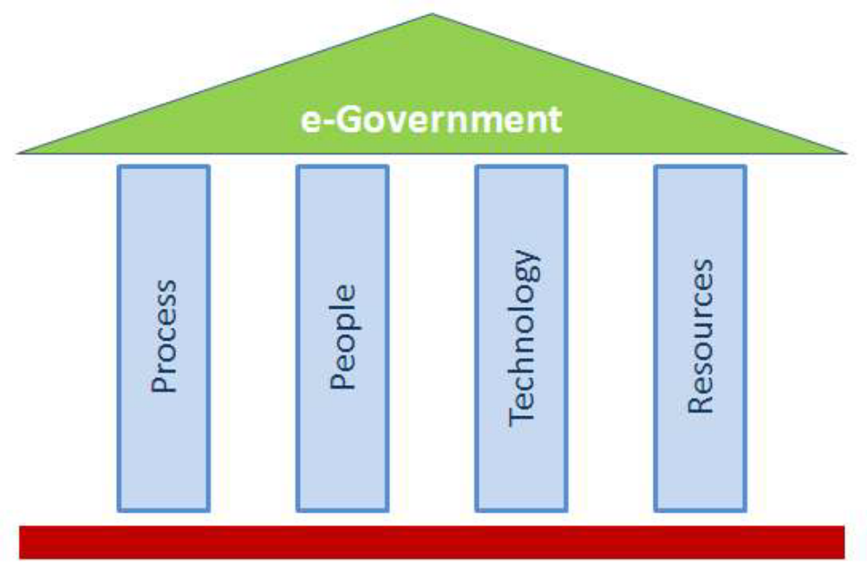
4 PILLARS of e-governance

Slide 12

e-governance is a journey and not a destination
Major task : Simplifications & speeding.
➢ Two main goals :
1. Process integration as electronic back
office including training of civil servants.
2. Harmony of e-services.

Slide 13
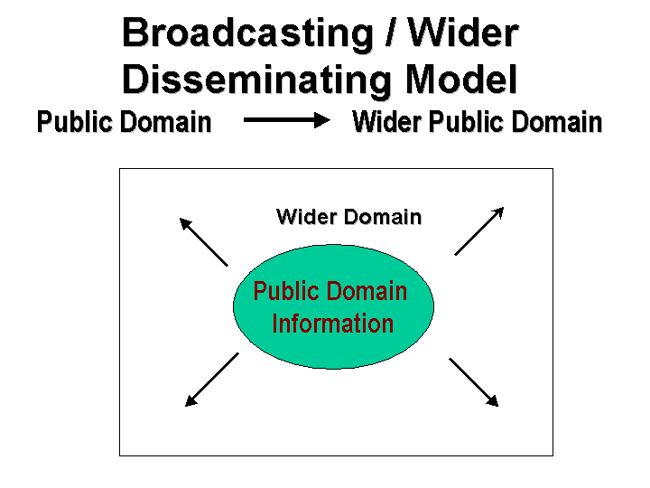
E-Governance models
Broadcasting Model-The model is based on dissemination / broadcasting of useful governance information which is in the public domain into the wider public domain through the use of ICT and convergent media. The strength of the model rests upon the fact that a more informed citizenry is better able to judge the functioning of existing governance mechanisms and make an informed opinion about them. As a consequence, they become more empowered to exercise their Righ This model could be applied in the following possible ways:
Putting Governmental Laws and Legislations online.
Making available the names, contact addresses, emails, fax numbers of local/ regional/ national government officials online.
Make available information pertaining to Governmental Plans, Budgets, Expenditures, and Performances online.
Putting key Judicial decisions which are of value to general citizens and create a precedence for future actions online. viz. key Environmental Decisions, State vs. Citizen decisions etc.

Slide 14
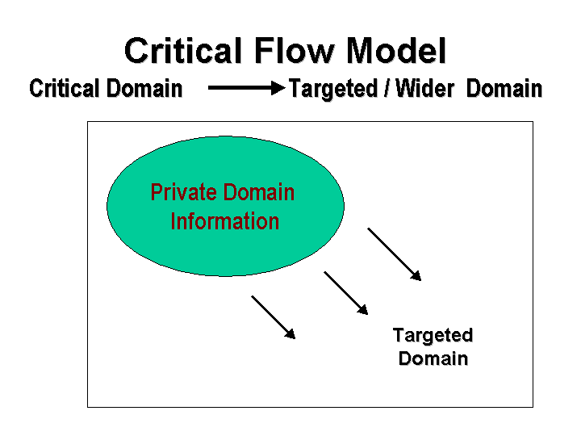
Critical Flow Model - The model is based on disseminating/ channeling information of critical value (which by its very nature would not be disclosed by those involved in bad governance) to the targeted audience (such as the media, opposition parties) or into the wider public domain through the use of ICT and convergent media. This model could be applied in the following possible ways:
Making available Corruption related data about a particular Ministry / Division/ Officials online to its electoral constituency or to the concerned regulatory body.
Making Human Rights Violations cases violations freely available to Judiciary, NGOs and concerned citizens.
Making available information that is usually suppressed, for instance, Environmental Information on radioactivity spills, effluents discharge, information on green ratings of the company to concerned community.

Slide 15
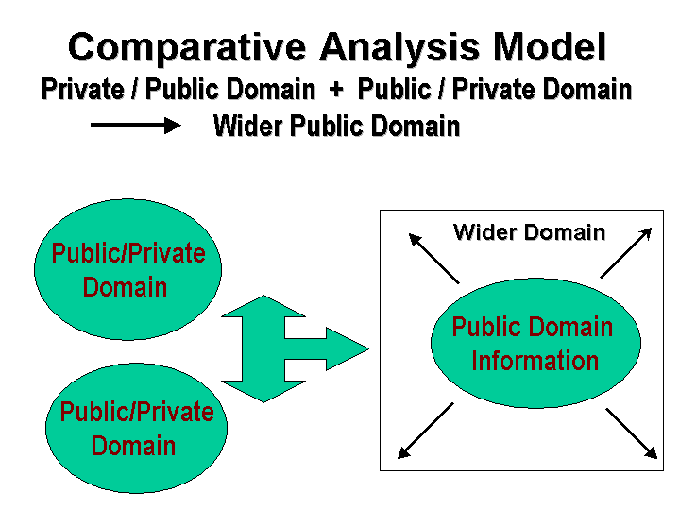
Comparative Analysis Model - Comparative Knowledge Model is one of the least-used but a highly significant model for developing country which is now gradually gaining acceptance. The model can be used for empowering people by matching cases of bad governance with those of good governance, and then analyzing the different aspects of bad governance and its impact on the people.
The model is based on using ICT to explore information available in the public or private domain and comparing it with the known information sets. The outcome is strategic learnings and arguments, for instance, if a given amount of money can build '5' schools in village 'A' then why does the same amount of money build only '2' schools in village 'B'?
Essentially, the model continuously assimilates Best Practices in the areas of governance and then uses them as benchmark to evaluate other governance practices. It then uses the result to advocate positive changes or to influence 'public' opinion on these governance practices.

Slide 16
Interactive Service Model - Interactive-Service model is a consolidation of the earlier presented digital governance models and opens up avenues for direct participation of individuals in the governance processes. Fundamentally, ICT have the potential to bring in every individual in a digital network and enable interactive (two-way) flow of information amongst them. The potential of ICT for the governance is fully leveraged in this model and can bring transparency in decision-making processes.
Under this model, the various services offered by the Government become directly available to its citizens in an interactive manner. It does so by opening up an interactive Government to Consumer to Government (G2C2G) channel in various aspects of governance, such as election of government officials (e-ballots); online grievance-redressal; sharing of concerns and providing expertise; opinion polls on public issues etc.

Slide 17
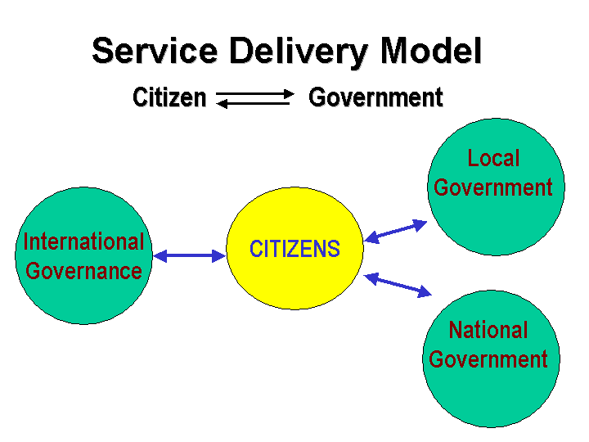
This model could be applied in the following possible ways:
To establish an interactive communication channels with key policy-makers and members of Planning Commissions.
To conduct electronic ballots for the election of government officials and other office bearers.
To conduct public debates / opinion polls on issues of wider concern before formulation of policies and legislative frameworks.
Filing of grievances, feedback and reports by citizens with the concerned governmental body.
Establishing decentralised forms of governance.
Performing governance functions online such as revenue collection, filing of taxes, governmental procurement, payment transfer etc.

Slide 18
Case Study : CIC
(Central Information Centre)
Administrative blocks wise implemented in whole North East region.
Objectives
  Bridge the digital divide - Digital Divide refers to the gap that exists between different people and societies because of the access or no access to information technology. This can either be the lack of technology in the physical form or the lack of skills for using the technology. Digital Divide can occur on the basis of Gender, income, race, location etc. Another term used is the global Digital Divide which is used for referring to the digital divide that exists between different countries.
  Providing information regarding local resources,local demographic parameters, Internet connectivity and services delivery to citizen.
  Enabling a platform for interaction.
  Distance learning programme.
  Generation of employment opportunities
Falls under GTG and GTC categories

Slide 19
Case Study : CIC
A citizen's concerns
  Unaware of the schemes being implemented for economically backward people.
  Low level of literacy.
  Feel uncomfortable while using the facilities.
  Not aware of source of information.
  Concern related to market.
  No information on Educational opportunities.
  No information on Job.

Slide 20
Case Study : CIC
Solution in the form of CIC:
  Government to Citizen(G2C) services delivered from the CICs such as
    Birth and Death Registration
    Prices and other market information of Agricultural produce
    Information on Educational opportunities
    Job portals etc.
  Effective and cheap medium for reaching the masses.
  Know Your CIC helped to reduce corruption.
  Motivation and awareness camps for different purposes.

Slide 21
Other CIC features
Providing PAN Status and On-Line PAN card Application by CIC- Dimoria.
An Exposer of online Election result.
Video recording of Interview of local prominent person.
Computer-Aided Paper less Examination System (CAPES) Test.
Online access of common entrance exam result of eng and medical.

Slide 22
Why CIC succeeded
Able to develop business model for future sustainability.
Better public awareness.
Community participation
Forward and backward linkage - Channels through which information, material, and money flow between a company and its suppliers and create a network of economic interdependence is backward linkage. Distribution chain connecting a producer or supplier with the customers.
Creation of knowledge based society.
Penetration among youth.
Diversification of services.

Slide 23
Case Study: Suwidha
State wide project implemented in Punjab
Objectives
  Provide friendly and efficient interface between government and citizens
  Provide transparency in government operations
  Provide timely and efficient service delivery
  Improve quality of government services
Falls in the government to citizens category

Slide 24
Case Study: Suwidha
A citizen's concerns
  Different branches for different services
  Not familiar with the procedures
  Unaware of the schemes being implemented
  Not aware of source of information
  Has to frequently visit the branch to ensure movement of the case and to enquire the status
  Services are not delivered as scheduled
  Has to visit many offices for a single service
  Small payments require visiting banks for services

Slide 25
Case Study: Suwidha
Solution in the form of Suwidha
  The citizen approaches SUWIDHA Queue Counter and gets the Queue Token number.
  On his turn at SUWIDHA Service Counter, he files his application.
  She/he is issued a receipt cum token number, which specifies the date of delivery of services. Each type of service has a pre-defined delivery time and system automatically calculates the service delivery date.
  All kind of payments for the fees etc can be made at the SUWIDHA counter.
  The application/case is then sent to the branch for action.
  In between the citizen can track the case with the help of SUWIDHA Token number through DialCITI (which is IVR(interactive voice response, based system) or website.
  The delivery of documents/processed case is made on the specified date. The delivery of the documents is also from SUWIDHA Delivery Counter.

Slide 26
Case Study: Suwidha
Other Suwidha features
  On the spot photograph capture wherever required
  Information on schemes and procedures
  Application forms available
  Provision of on the spot delivery of services in cases where verification can be ensured based on the data available in the databases
  Implemented in all 17 DC(Deputy Commissioner) offices and 54 SDM(Sub District Magistrate or Senior Deputy Minister) offices of Punjab

Slide 27
Case Study: Suwidha
Why Suwidha succeeded? (Take aways)
  Government process re-engineering
  Increased accountability
  Power through information
  Ease of access
  Localization
http://suwidha.nic.in

Slide 28
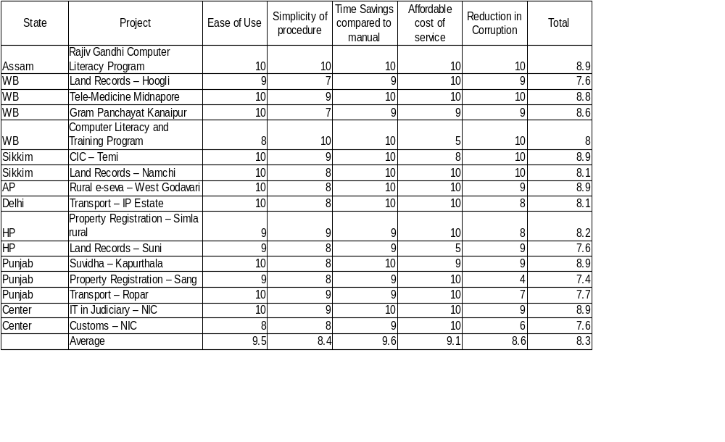
How successful has e-governance been in India?

Slide 29
E-governance Best Practices
Increased accountability
Increased transparency
Higher availability of public domain information
Reduced corruption
Higher penetration due to automation
Increased efficiency due to connectivity
PROCESS RE-ENGINEERING – technology only a tool not panacea

Slide 30
E-governance Scalability
Most projects till now have been pilot projects
A few things to keep in mind
  Sustainability
  Evaluation and impact assessment
  Accountability
  Training for civil servants
  Private partnership
Pilot, Plan, Replicate, Revise and Scale

Slide 31
Outline of presentation
Relevance of e-Governance for India
Lokvani
1. Front-end (What)
2. Back-end (How)
3. Process of implementation (How)
e-Governance in Police

Slide 32
India can’t be a Developed Country
if
It is not e-Governed

Slide 33

Why?

Slide 34
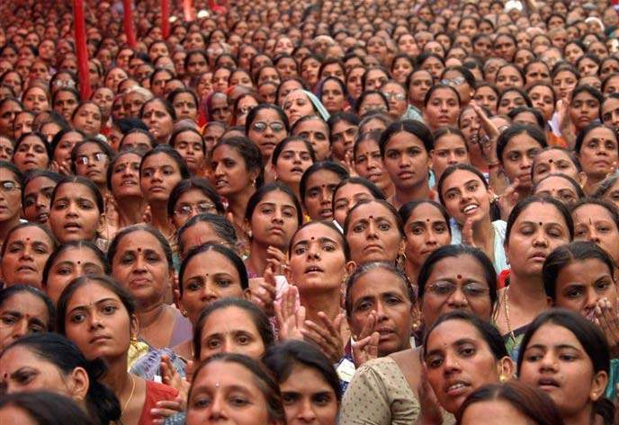
Large Population

Slide 35

Wide Spread Corruption

Slide 36
Implementing RTI Act (Right To Information) 2005 is impossible without e-Governance.

Slide 37
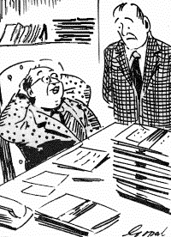
Slow & lethargic beurocracy

Slide 38
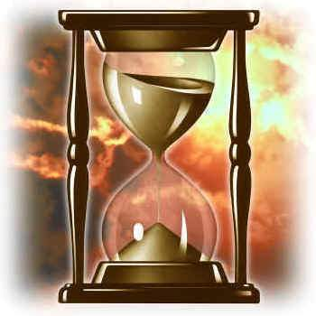
Long decision time

Slide 39
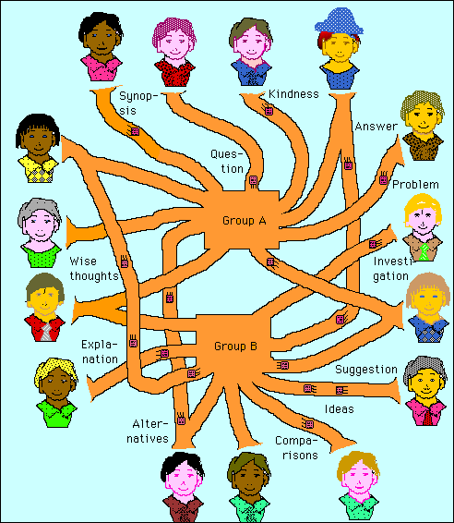
Can we be e-Governed nation?

Slide 40
Yes

Slide 41



Our Past Successes
Bhoomi
Railway Reservation System
Banks
E-Seva

Slide 42
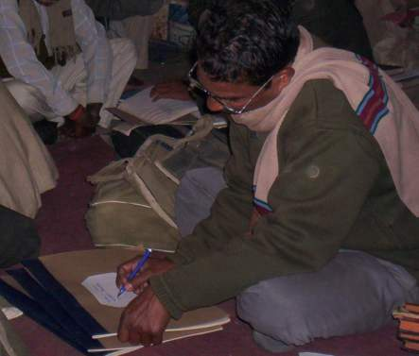
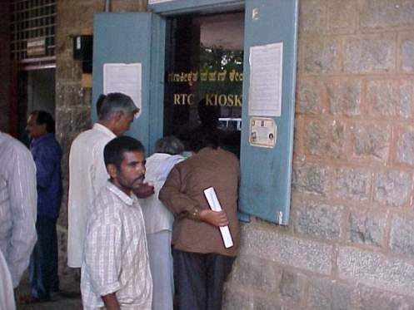
Bhoomi
Notes:
Photographs to be inserted

Slide 43
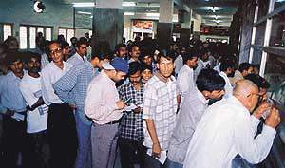
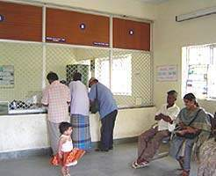
Railways
Notes:
Photographs to be inserted

Slide 44
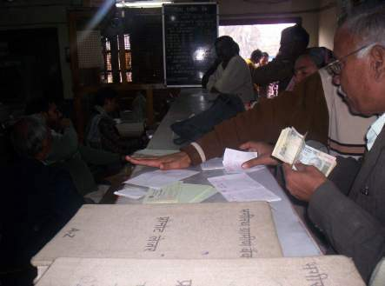
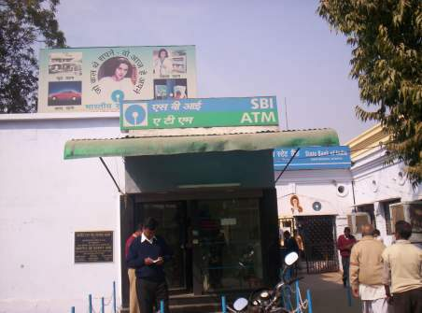
Banks
Notes:
Photographs to be inserted

Slide 45
How?

Slide 46
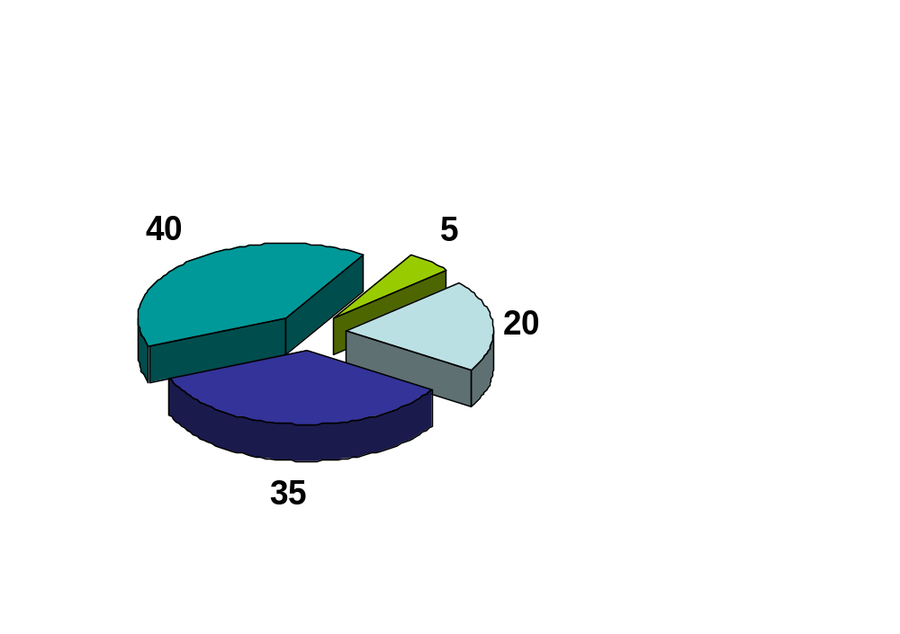
e-Governance:Components of Success
%
% Luck
Change management
%
Technology
%
Business Process Reengineering

Slide 47
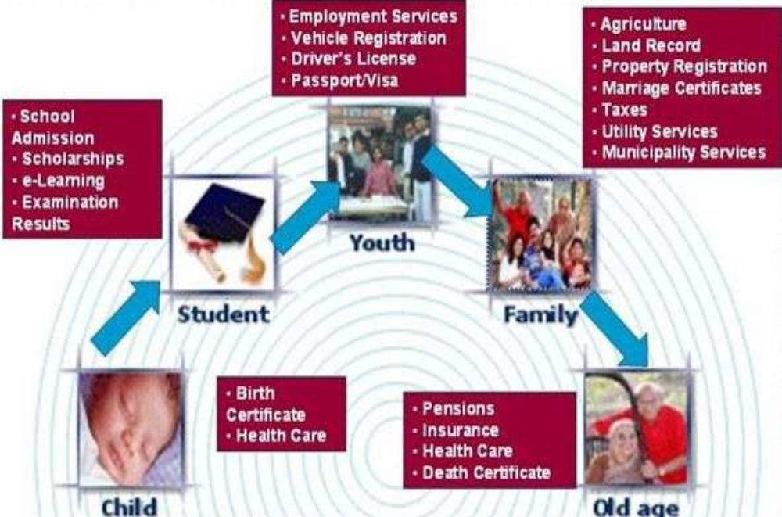
SCOPE of e-governance

Slide 48
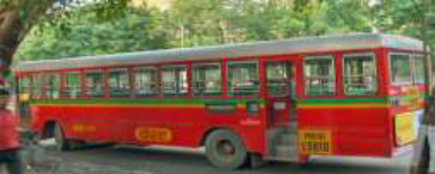

Major implementation areas
Public Grievances: Ration Card ,
Transportation facilities.
Rural Services: Land Records.
Police: FIR registrations , Lost and Found details.
Social Services: Birth , School , Death Certificates.
Public Information: Information about
Employment , Hospitals , Railways ,etc.
Agricultural Sector: Fertilizers , Seeds.
Utility Payments: Electricity , Water, Telephone bills.
Commercial: Income tax , Custom duty , Excise duty.

Slide 49
Challenges of e-Governance
in North India
  Computerization seen more as a publicity tool, a fashion than for any real purpose. Hence no people’s support for it.
  Mindset of Government employees (fear of losing extra income).
  More efforts for G2G than G2C, leading to no perceptible benefits to common people.
  Infrastructure, power, and communication problems
  Education, illiteracy

Slide 50
Lokvani

Slide 51
Our Role Models
  Computerized railway reservation system
  Bhoomi, Karnataka

Slide 52
What is Lokvani?
Lokvani
is
an Internet kiosk based G2C interface
for
providing various information and public grievance redressal in a transparent, accountable and time-bound manner
by
effective Public-Private Partnership (PPP)

Slide 53
Public Grievance Redressal -Existing System
Senior
Officers
?
Departmental
officers
Field level
officers/employees
Common man
Notes:
The basic concept is borrowed from railway ticketing

Slide 54
Public grievance redressal-Lokvani System
DM
(divisional magistrate)
office
Lokvani
Server
Concerned
Department
Third Party,
Lokvani Kiosk
customer

Slide 55
Welcome to LOKVANI…
www.sitapur.nic.in/lokvani

Slide 56
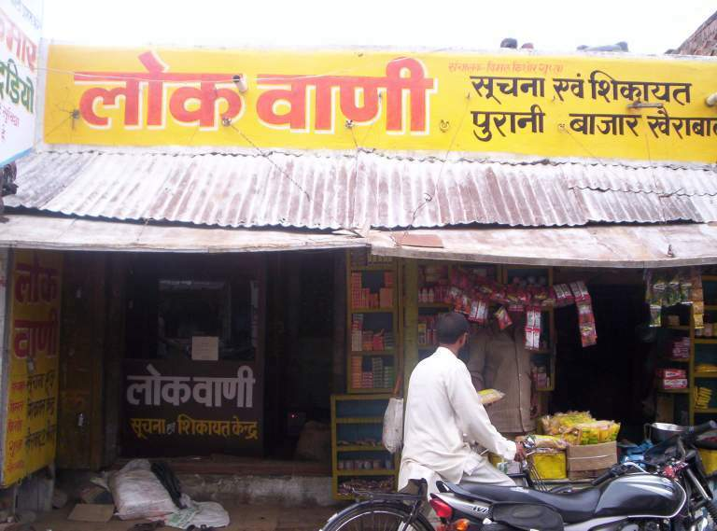
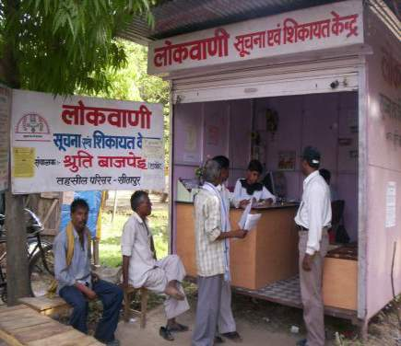
Typical Lokvani kiosk…

Slide 57
Proposed Services…
Online court cases, cause lists, judgements
Online Electoral Rolls
Vehicle Registration, Driving License
Payment of electricity bills, phone bills
Ration cards and allotment to qotedar.
Police thana computerization / networking connectivity
Tourist Related information
Daily rates of Fruits/ Vegetables/ Grains
Online pensioners info. / Installation of IVRS (Interactive Voice Response)
Parivar register Database (Rural & Urban)
All employees Database
University/ College info. (Seat Availability, Admission)

Slide 58
Proposed Services (Contd…)
Health info. (All Hospitals/ Nursing Homes/ Laboratories)
Recovery Certificates (R.C.s)
Industries info (Durry exporters etc.)
Registry of properties
Banking Services
Drinking Water facilities Database
Development from MP/MLA funds

Slide 59
Contd....
Khasra(Hindi-Urdu word: legal agricultural document used in India and Pakistan that specifies land and crop details. It is a reference map of the village that administers the land described by the khasra. Khasras traditionally detail "all the fields and their areas, measurement, who owns and what cultivators he employs, what crops, what sort of soil, what trees are on the land." and Jamabandi(A jamabandi is a term used in India meaning "rights of records" and refers to land records.
These records are documents which are maintained for each village within its Tehsil. It is revised after a certain period of time for e.g. in states like Punjab, Haryana, Rajasthan it is revised after 5 years.)
SC/ST tracker

Slide 60
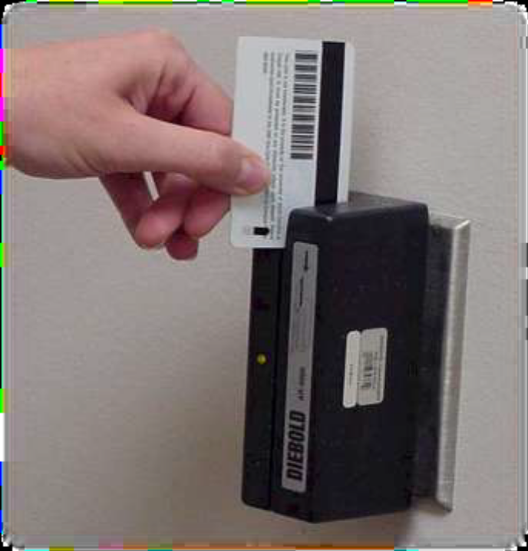
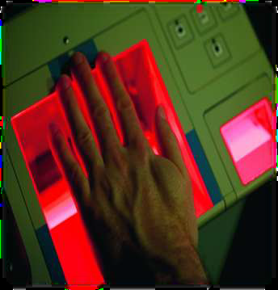
E- services
Card swipe
Computerized Palm Impression

Slide 61
Will it Sustain?
Kiosk operators are partners & motivators
Cost saving
Taste of convenience , no roll back
Public satisfaction
Most ignored group, feeling of regaining faith in administration

Slide 62
Replicability
Easy to replicate
Backing of Laws, Rules
Monitoring from state level
Who gets the credit?

Slide 63
Strengths of Lokvani…
Transparency and accountability to complainant.
Complete transparency in all works / schemes / beneficiaries / selection / expenditure etc.
Compulsion to come to District / Tehsil Head Quarter avoided.
Effective monitoring of all complaints / grievances. Monitoring of performance of district level officers is possible by senior officers at state headquarter.
24X7 services.
Easily replicable
Job creation in rural areas
Bridging the digital divide

Slide 64
Uniqueness of Lokvani
First successful zero support based PPP model for kiosks in the country
Profit and competition can overcome power shortage, illiteracy, poverty, adverse socio-political conditions, lack of professional work culture
100,000 rural people using it in just one district
Going beyond just provision of services to make the govt. accountable and giving the citizen the right to answer
Notes:
The stages of e-Governance-1.Games 2.word processing 3.Computerization(MIS) 4.G2C(bill payment, SWK, other services) 5. Accountability and answerability

Slide 65
Achievements…
About 100,000 complaints registered and 95000 disposed off in about 30 months.
First successful e-Governance project in Uttar Pradesh
First District in country to provide On line Land records on Internet in Hindi.
Government of UP has come out with a G.O. to implement Lokvani in all Districts of U.P

Slide 66
Issues…
Quality vs. Quantity
Replicability
Sustainability
People meeting personally on Janata Diwas, Janmilan etc.
State Level Monitoring
Search

Slide 67
Lessons Learnt…
Better copy than reinvent the wheel
Seeing is believing
Team spirit (giving credit/appreciation/freedom)
Best is the enemy of good
Failure is the pillar of success
Socializing helps
No subsidies
No need to be a technocrat
PPP is must for sustainability
Strategy (calculated moves)
Use of media and politicians
No limit to achievement, if no desire for credit

Slide 68
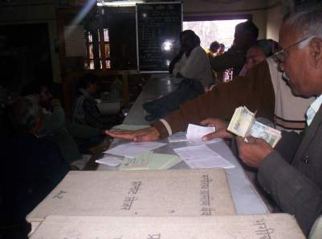

Role Model

Slide 69
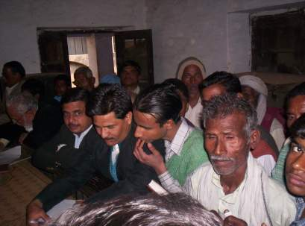
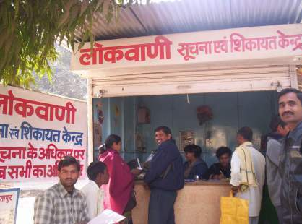
Our Vision

Slide 70
e-Gov in Police

Slide 71
Whether you like it or not, you have no choice but to implement e-Governance.
The only choice you have is to choose your favorite dish from a big menu…….

Slide 72
Some dishes
P.S. Automation
  Record keeping
  Interlinking
  Process re-engineering
  Online FIR(First Information Report)
Traffic
  Challan Process
  Traffic lights & control room
  Linking with RTO office
  Vehicle thefts (RFID-Radio Frequency Identification, GPS-Global Positioning System), database of lost and recovered vehicles
Verifications
  Arms License
  Passport
  Govt. jobs
  Army recruitment
  Household servant’s credentials
Investigations
  Case tracking ( from FIR to conviction till SC)
  Inventory Management (of maal mukadmati)

Slide 73
Some dishes….contd
Communications
  CUG(Closed User Group)
  Triband phone
  Video Conferencing (G2G & evidence)
  Vehicle tracking
  Biometric devices
Crime data Management
  Data Warehouse
  Business Intelligence Softwares
  Mugshot & fingerprint database
  Handheld online devices & online matching

Slide 74
Online FIR
Increase in crime figures
Lack of manpower to investigate all the crimes
Political & administrative will
Weak 182 IPC
Lack of resources

Slide 75
Acknowledgements
Sri Rajeev Chawla Ex-Secy e-Gov, Karnataka
Smt.Zohra Chatterjee (Govt. of UP)
NIC (Sri S.B.Singh, A.P.Singh, AjaiGopal, Rajeev Lakhera and many others )
Mr.Alok Singh, IPS
Mr.Abhishek Singh, IAS
Mr.Sanjay Bhoosreddy, IAS
Justice S.C.Verma

Slide 76
Conclusion
35% of e-governance projects in developing regions are complete failure; 50% are partial failures; only 15% are completely successful
It is still worth the effort if the successful projects can be scaled.

